Slide 1
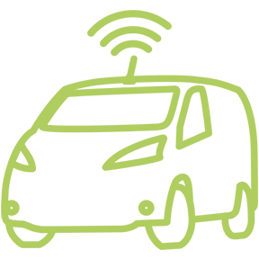
Poking at the Future of Autonomous Vehicle Effects
Like a Lab Rat
Ronald T. Milam | AICP, PTP
FEHR & PEERS
June 2019
Notes:
How many of you like a good mystery? Well this presentation is about the mystery of disruptive trends and how they will influence the future of travel. To me, what’s exciting about this particular mystery is that all of us in this room have a role to play in how the mystery will play out. So you can think of this presentation as the first book in a good mystery series. I’m not yet sure if it’s a trilogy

Slide 2
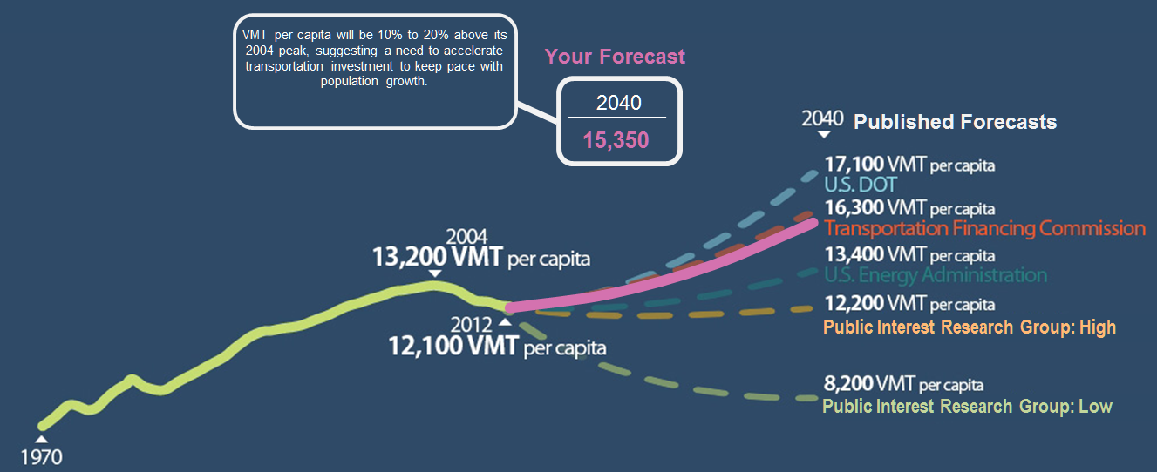
Why we did this
Reduce uncertainty

Slide 3
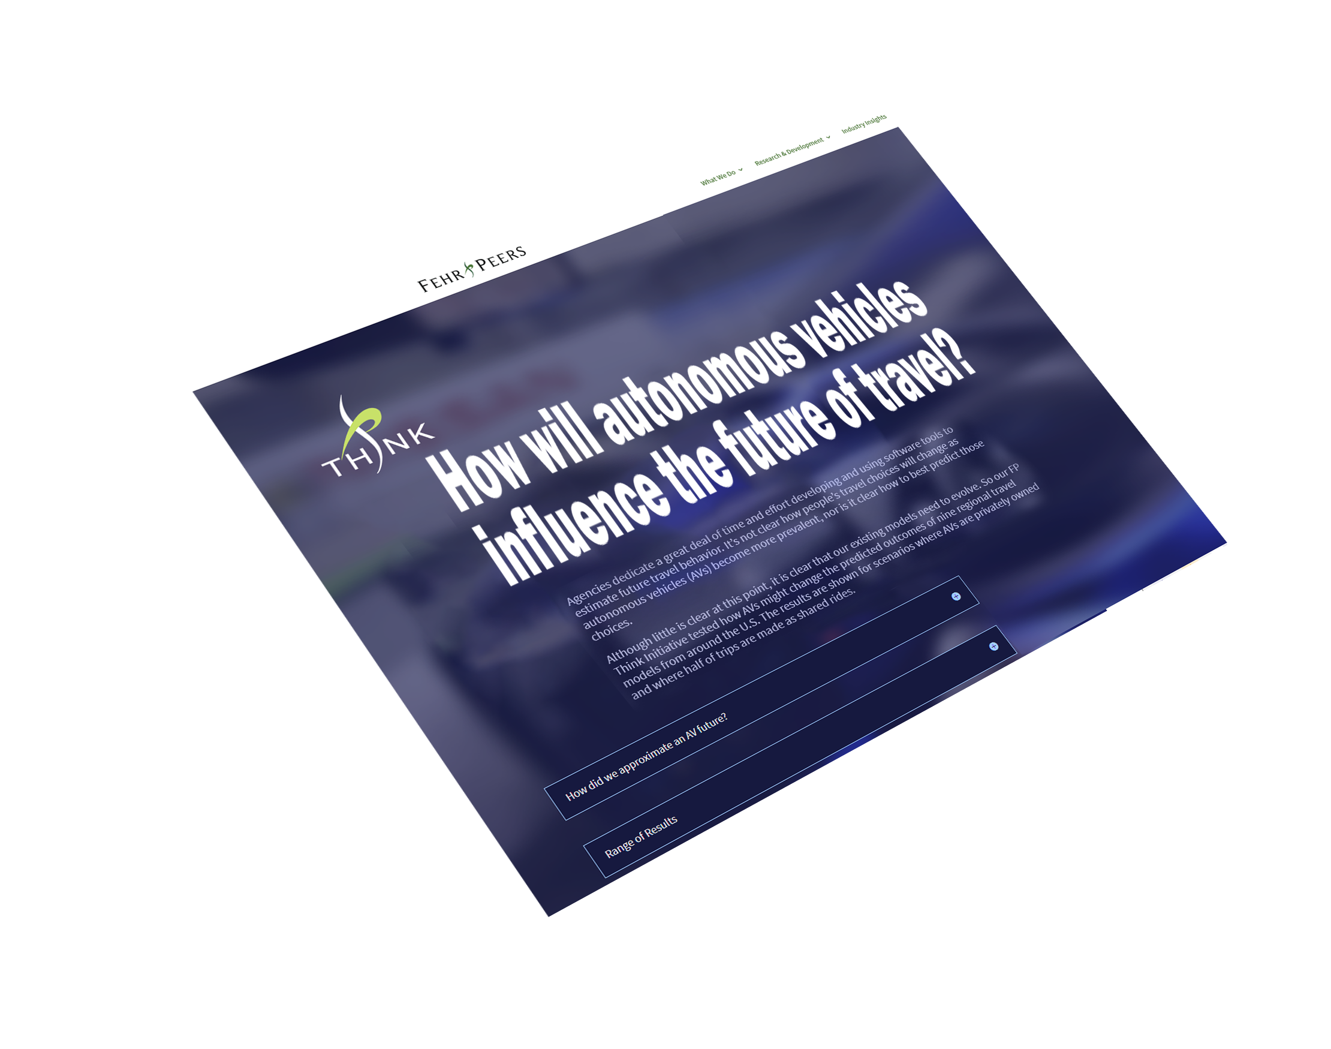
Modeling AV Effects
10
Regional Travel Demand Models
Sensitivity and Stress Tests
2
Freeway Simulations

Slide 4
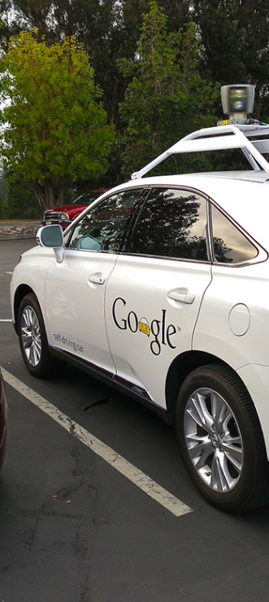
Sensitivity Tests
Single Scenario
Decrease access time
Decrease parking costs
Decrease impact of lost in-auto time
Increase auto availability
Increase freeway capacity
Increase non-work trip-making
Increase auto occupancy

Slide 5
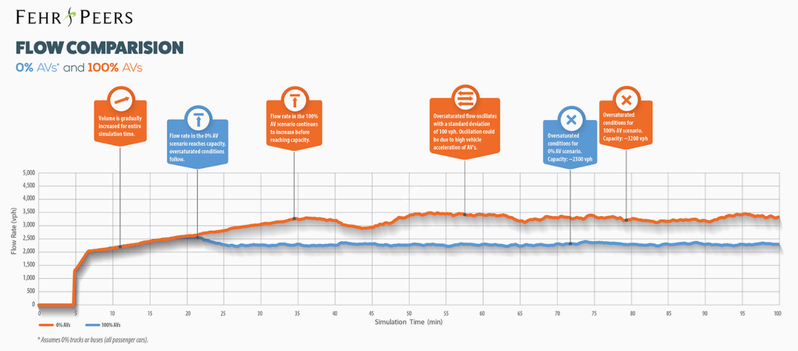
Increase Freeway Capacity
Influence of Car Following, Reaction Time, and Cooperation

Slide 6
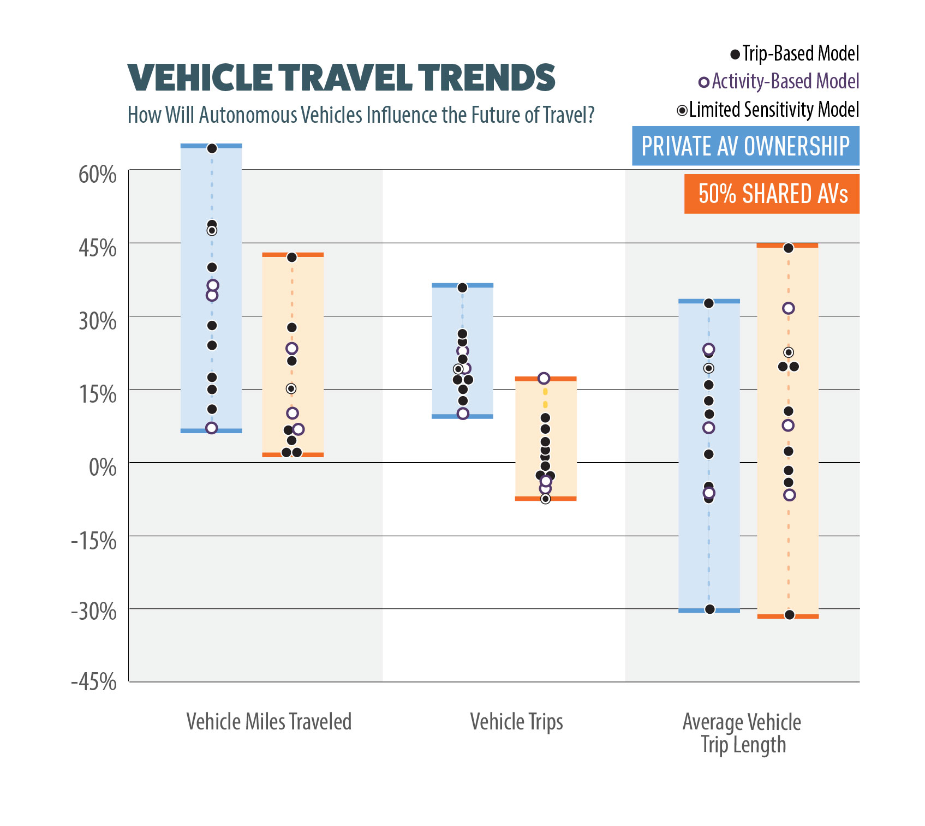
Vehicle Results

Slide 7
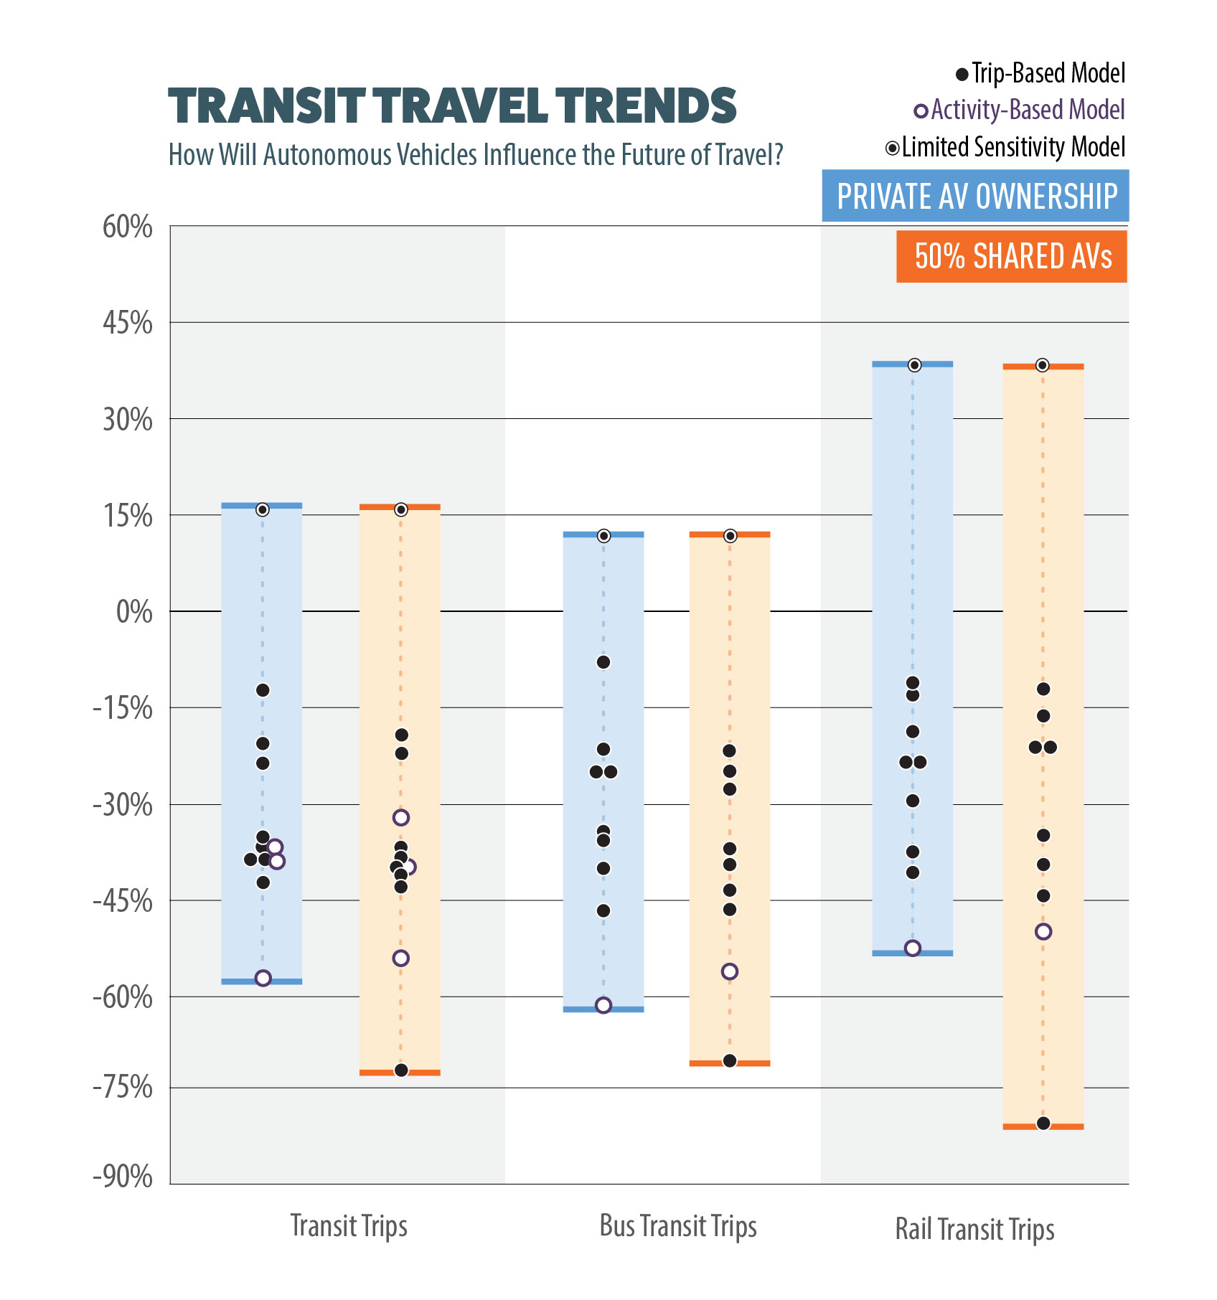
Transit Results

Slide 8
Other Research Evidence
Experimentation

Slide 9
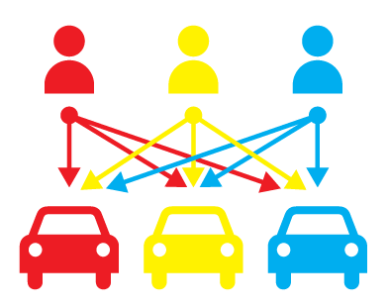
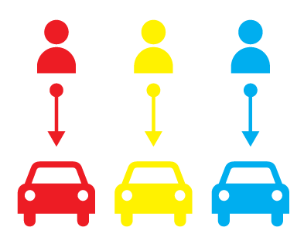
Countermeasures
Policy Response Testing
Private and Mine
Shared

Slide 10
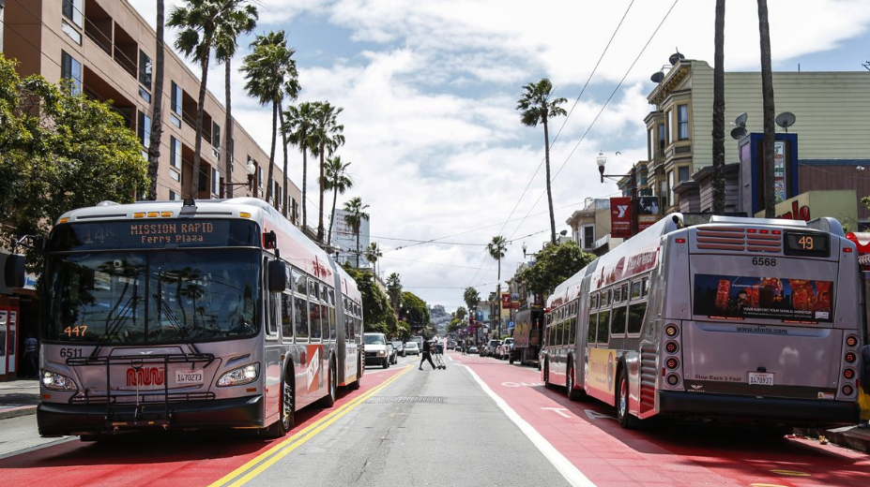
Policy Response
Transportation Network Space Allocation, Modal Priority, and Pricing

Slide 11
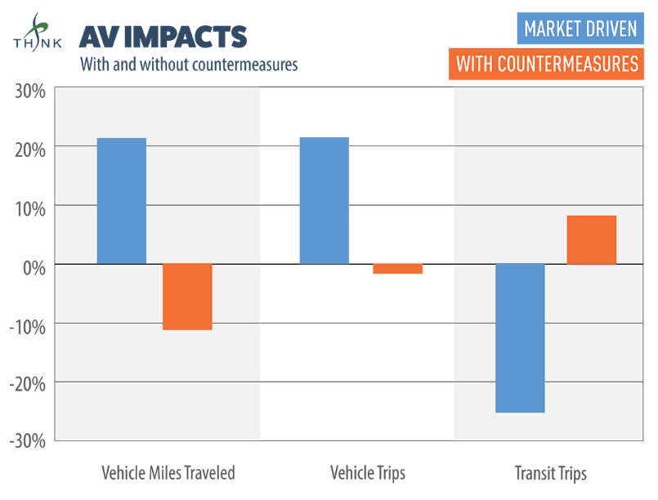
Countermeasure Results
What Can we Infer?

Slide 12
Poking at the Future of Autonomous Vehicle Effects
Like a Lab Rat
Ronald T. Milam | AICP, PTP
FEHR & PEERS
June 2019
Notes:
How many of you like a good mystery? Well this presentation is about the mystery of disruptive trends and how they will influence the future of travel. To me, what’s exciting about this particular mystery is that all of us in this room have a role to play in how the mystery will play out. So you can think of this presentation as the first book in a good mystery series. I’m not yet sure if it’s a trilogy

